Slide 1


COLLECTION LIBRARY AND CONTEXT MANAGER
In Python

Slide 2
Introduction
One common problem we face in programming is how to properly manage external resources, such as files, locks, and network connections. Sometimes, a program will retain those resources forever, even if we no longer need them. This kind of issue is called a memory leak because the available memory gets reduced every time you create and open a new instance of a given resource without closing an existing one.
Managing resources properly is often a tricky problem. It requires both a setup phase and a teardown phase. The latter phase requires you to perform some clean-up actions, such as closing a file, releasing a lock, or closing a network connection. If you forget to perform these clean-up actions, then your application keeps the resource alive. This might compromise valuable system resources, such as memory and network bandwidth.

Slide 3
In Python, you can use two general approaches to deal with resource management. We can wrap our code in:
A try … finally construct
A with construct
The first approach is quite general and allows us to provide setup and teardown code to manage any kind of resource. However, it’s a little bit verbose. Also, there are chances we might forget to perform some cleanup actions.
The second approach provides a straightforward way to provide and reuse setup and teardown code. In this case, you’ll have the limitation that the with statement only works with context managers.

Slide 4
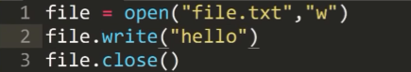

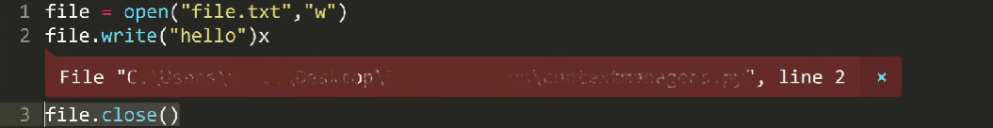
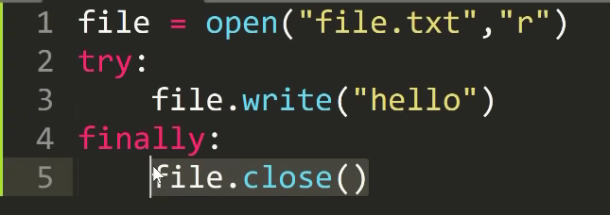

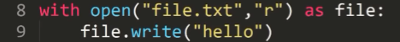
Now in case, we’ve already initiated the open file code, now
If anything in between gets an error message the flow of
code doesn’t reach the end file statement and the file
doesn’t get closed, occupying some memory within the system.
For ex:
So in order to get away from this problem, one such approach is the try…..finally construct, as shown in the
1st example below: However, it’s quite verbose and this is where with construct kicks in.
If you look at the code here, we didn't close the file & there is no try/finally
block. Because with statement automatically closes file.txt .
You can even check it by calling file.close() attribute, which will return True.
This is because the file objects (‘file’ in this example) returned by open function has two built-in methods
__enter__ and __exit__. It is also known as context manager.

Slide 5
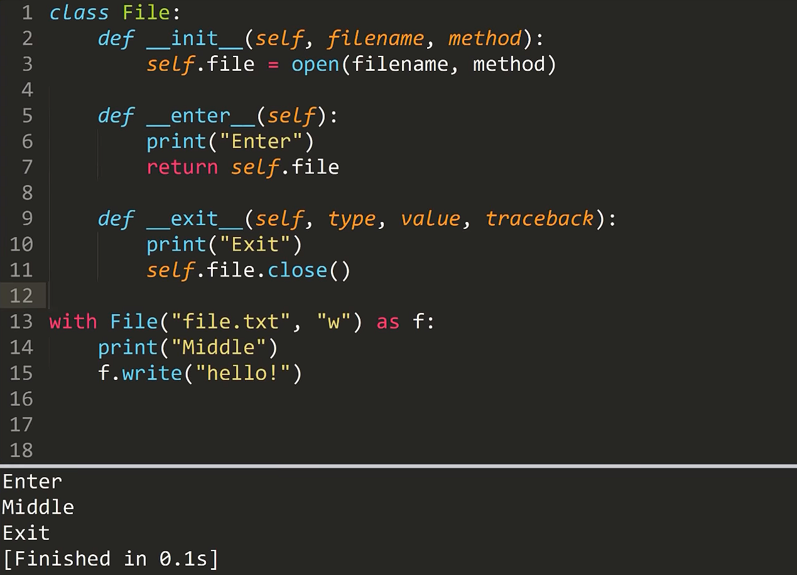
Implementation of Context manager
One of the ways of implementing custom context managers in Python is by implementing a context manager class using the __enter__ and __exit__ dunder methods.
Now , let’s define our own Context Manager
as a class:
__enter__ method is called at the start of with
statement and __exit__ method is called at the
end.

Slide 6
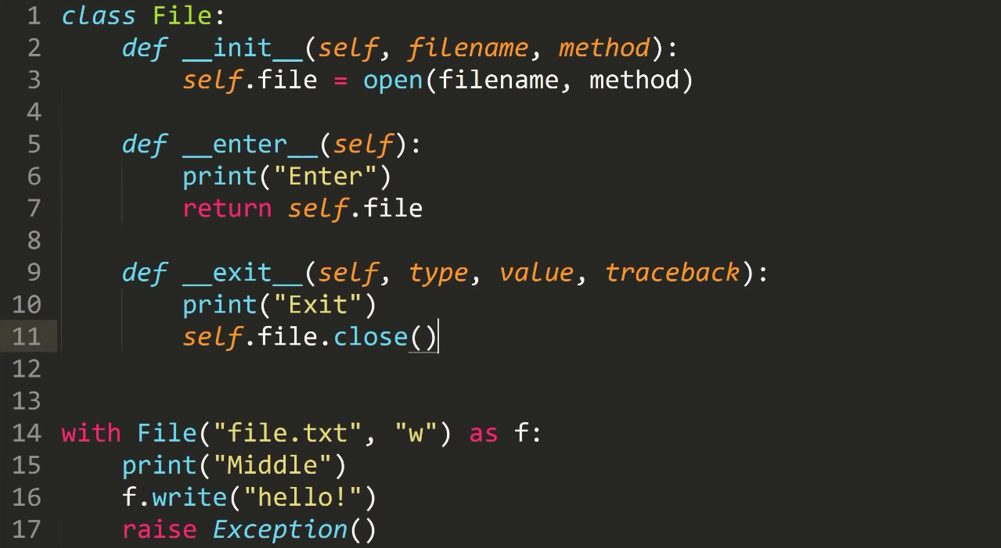
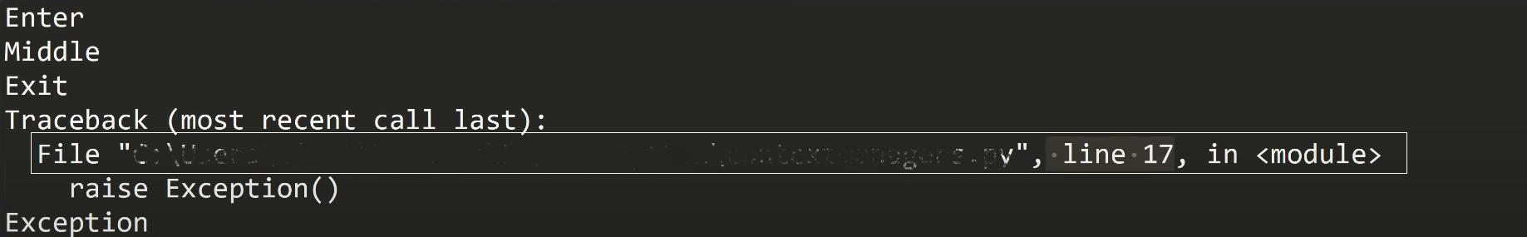

Slide 7
Merits of using Context manager
There are more benefits to using the with statement than just a more concise syntax.
The first advantage is that the whole allocation-release process happens under the control of the context manager object, making error prevention easier.
Encapsulates standard uses of try….finally statements in context managers.
Allows reusing the code that automatically manages the setup teardown phases of given operation.
Helps avoid resource leaks.
Context managers are one of those inherently Pythonic features that aren’t available in most languages. They provide a simple and elegant solution to a plethora of problems, even beyond resource management.

Slide 8
Collection Library
Python programming language has four collection datatypes- list, tuple, sets and dictionary. But python also comes with a built-in module known as collections which has specialized data structures which basically covers for the shortcomings of the four data types and reduces our number of lines of extra code.
The different containers provided by the collections module are:
Counters
OrderedDict
DefaultDict
NamedTuple
DeqQue

Slide 9
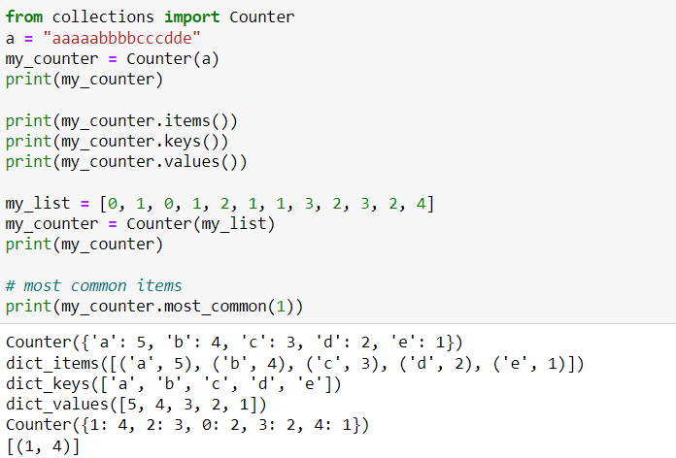
Counter
A counter is a container that stores elements as dictionary keys, and their counts are stored as dictionary values.

Slide 10
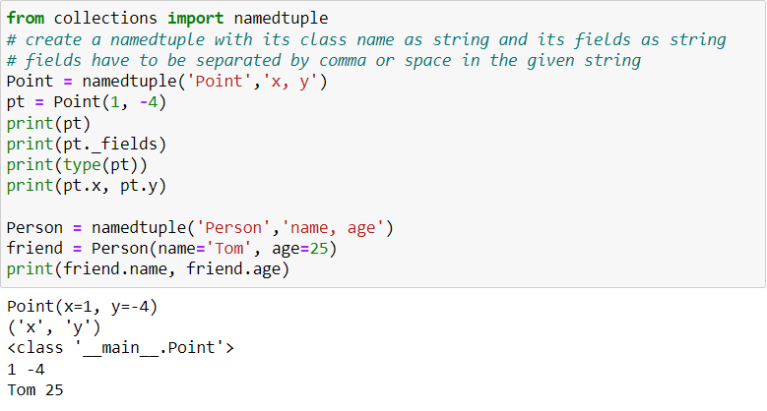
NamedTuple
Namedtuples are easy to create, lightweight object types. They assign meaning to each position in a tuple and allow for more readable, self-documenting code. They can be used wherever regular tuples are used, and they add the ability to access fields by name instead of position index.

Slide 11
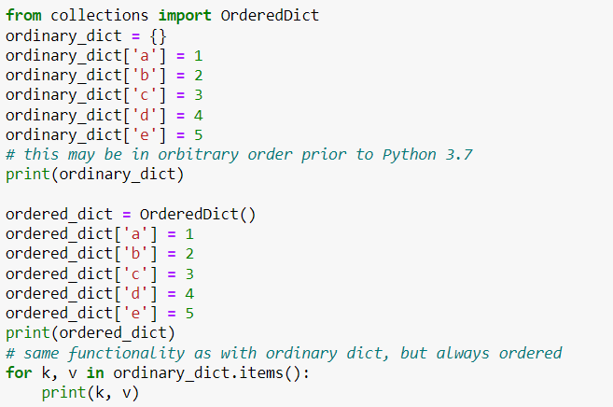
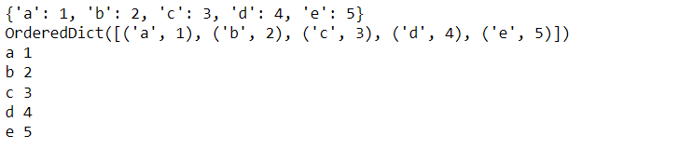
OrderedDict
OrderedDicts are just like regular dictionaries but they remember the order that items were inserted. When iterating over an ordered dictionary, the items are returned in the order their keys were first added. If a new entry overwrites an existing entry, the original insertion position is left unchanged.

Slide 12
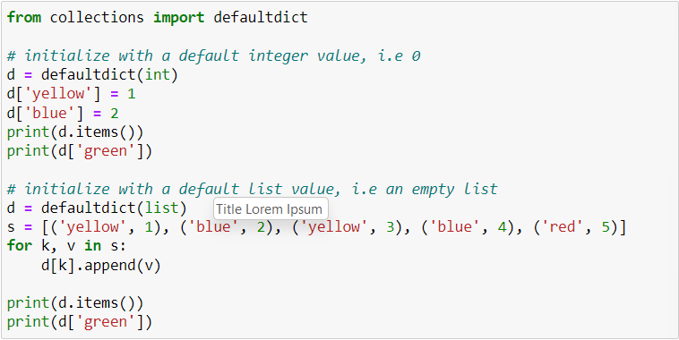
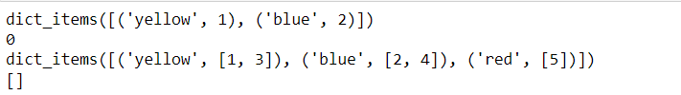
DefaultDict
The defaultdict is a container that's similar to the usual dict container, but the only difference is that a defaultdict will have a default value if that key has not been set yet. If you didn't use a defaultdict you'd have to check to see if that key exists, and if it doesn't, set it to what you want

Slide 13
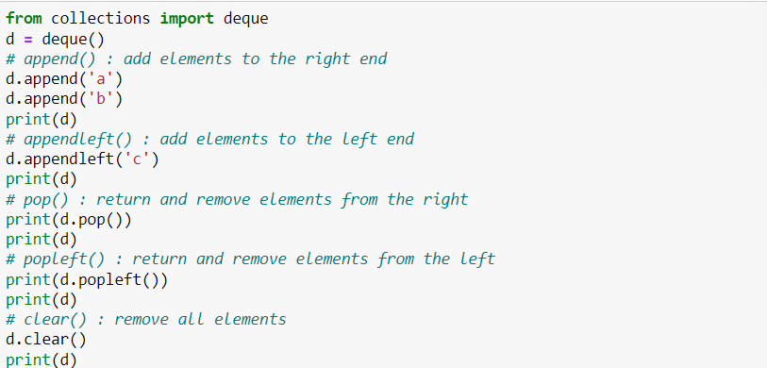
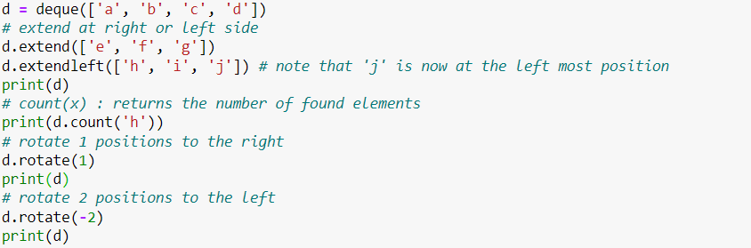
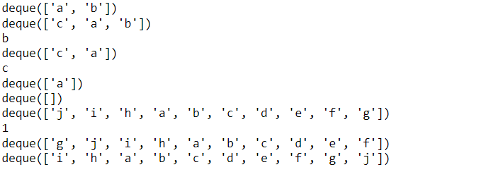
DeQue
A deque is a double-ended queue. It can be used to add or remove elements from both ends. Deques support thread safe, memory efficient appends and pops from either side of the deque with approximately the same O(1) performance in either direction. The more commonly used stacks and queues are degenerate forms of deques, where the inputs and outputs are restricted to a single end

Slide 14
THANKYOU

